Slide 1





SOURABH THAPLIYAL
Online Bookstore Management
ANUDIP ID = AF0414599
BATCH CODE : ANP-C8363
BATCH COORDINATOR : ANUJ KUMAR

Slide 2


Ingoude Company
Project Overview
The Online Bookstore Management System is a platform designed to simplify the buying and selling of books. It enables users to browse a wide selection of books, place orders, and leave reviews, while also offering administrators the ability to manage inventory, users, and orders efficiently. Built using Hibernate, the system utilizes a command-line interface (CLI) for user interaction, with secure authentication and role-based access for both users and administrators.

Slide 3



Goals
EFFICIENT BOOKSTORE MANAGEMENT
SEAMLESS USER & ADMIN EXPERIENCE
To develop a streamlined system for managing books, orders, users, and reviews using a command-line interface (CLI) while ensuring scalability and ease of use for both customers and administrators.
To provide secure, role-based access for users and administrators, enabling customers to easily browse and purchase books, while allowing admins to manage inventory and track orders effectively.
Search
Scientific Project

Slide 4

Requirement Analysis
01
User Features
Registration, login, placing orders, adding reviews.
02
Admin Features
Manage books and authors, user data, and order history.
03
System Requirements
Persistent storage with MySQL.
Secure user authentication and role-based access for admins.

Slide 5






Programming Language
Java
ORM Framework
Technology Stack
Hibernate
Database
a
MySQL
Development Environment
Eclipse
Version Control
GitHub

Slide 6


User Management
Registration, login, profile, orders.
Admin Management
Manage books, authors, users, and orders.
Modules Overview
Order Management
Place and track orders.
Review Management
Add and manage book reviews.

Slide 7
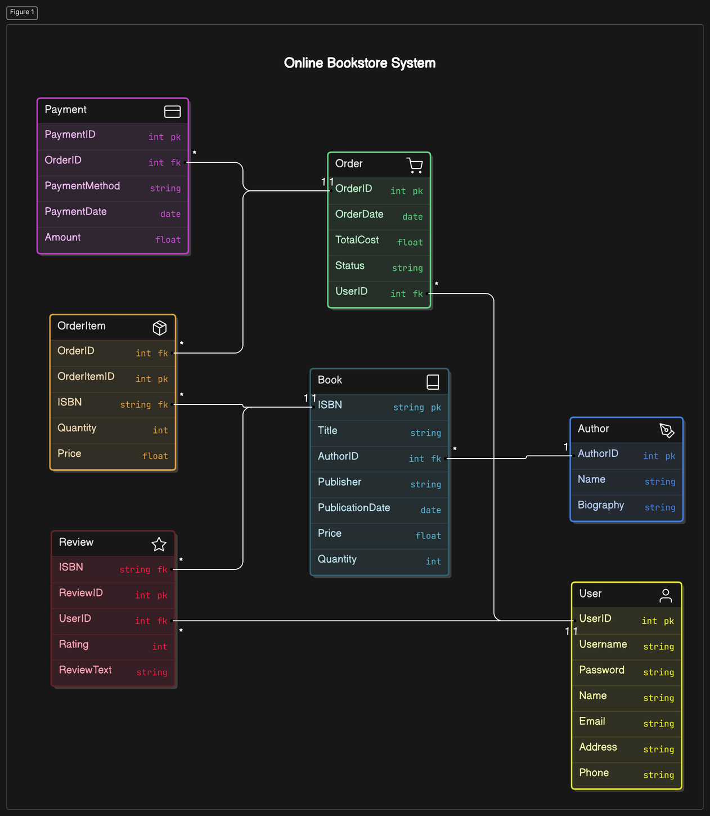
Database Design

Slide 8
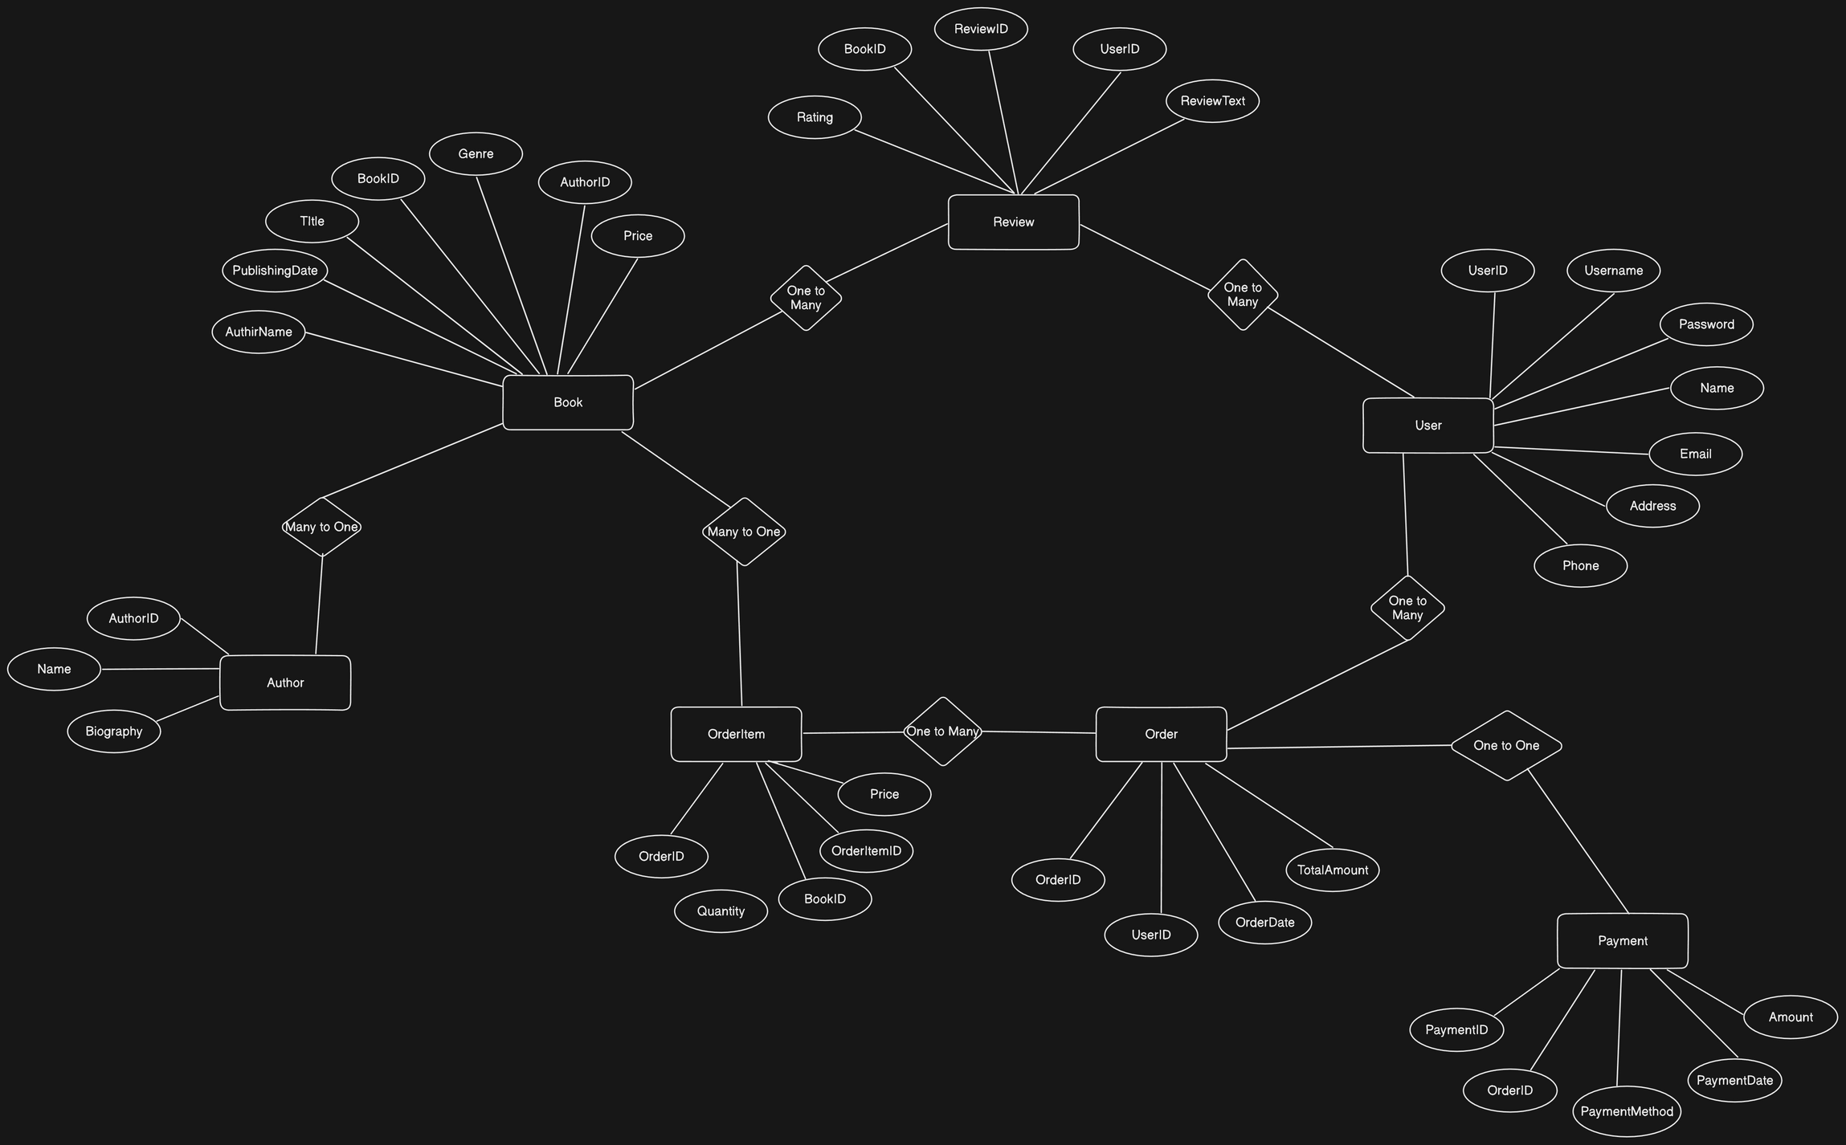
ER Diagram

Slide 9
Testing
Unit Testing
Integration Testing
Manual Testing
Used JUnit for testing components like controllers, services, and DAOs.
Ensured proper interaction between modules.
Extensive testing through the CLI interface.

Slide 10

Future Scope
GUI Development for better usability.
Performance optimization through caching mechanisms.
Mobile app version for wider accessibility.

Slide 11
Conclusion
In summary, the Online Bookstore Management System successfully delivers core functionalities such as user account management, book purchasing, and review capabilities, while providing robust administrative tools for inventory, user, and order management. The system leverages Hibernate for efficient database interactions and is built using a command-line interface for simplicity.
Looking forward, the project can be enhanced with a graphical user interface (GUI), improved performance through caching mechanisms, and scalability for mobile platforms, ensuring future growth and accessibility.

Slide 12

THANK YOU

